Slide 1
Android Application Development (I)
Practice – Object-Oriented Analysis and Design
Notes:
What is Object-Oriented Analysis and Design?
Then how about the opposite? Procedure Oriented Language?

Slide 2
Agenda
Self Introduction
Intellectual Property Rights
Project Introduction
Android Introduction
Get Started with Android
Requirement
Object-Oriented Analysis and Design
Scrum
Project Breakdown
Acceptance Test Criteria
Publish Application
Notes:
Object-oriented analysis and design (OOAD) is a software engineering approach that models a system as a group of interacting objects. Each object represents some entity of interest in the system being modeled, and is characterised by its class, its state (data elements), and its behavior. Various models can be created to show the static structure, dynamic behavior, and run-time deployment of these collaborating objects. There are a number of different notations for representing these models, such as the Unified Modeling Language (UML).
Object-oriented analysis (OOA) applies object-modeling techniques to analyze the functional requirements for a system. Object-oriented design (OOD) elaborates the analysis models to produce implementation specifications. OOA focuses on what the system does, OOD on how the system does it.
Ref: http://en.wikipedia.org/wiki/Object-oriented_analysis_and_design
IFRS - International Financial Reporting Standards
GAAP - Generally Accepted Accounting Principles

Slide 3
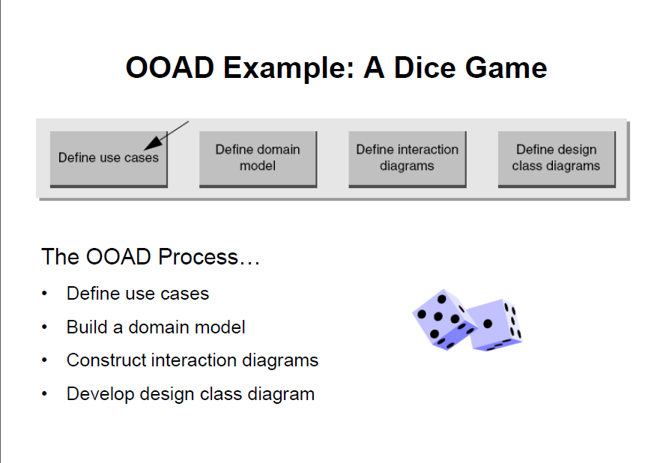
Object-Oriented Analysis and Design
Notes:
Domain model –The domain model is created in order to represent the vocabulary and key concepts of the problem domain. The domain model also identifies the relationships among all the entities within the scope of the problem domain, and commonly identifies their attributes. A domain model that encapsulates methods within the entities is more properly associated with object oriented models. The domain model provides a structural view of the domain that can be complemented by other dynamic views, such as Use Case models.
Ref: http://en.wikipedia.org/wiki/Domain_model
Problem Domain - A problem domain is the area of expertise or application that needs to be examined to solve a problem. A problem domain is simply looking at only the topics you are interested in, and excluding everything else. For example, if you were developing a system trying to measure good practice in medicine, you wouldn't include carpet drawings at hospitals in your problem domain. In this example the domain refers to relevant topics solely within your interest: medicine.
Ref: http://en.wikipedia.org/wiki/Problem_domain

Slide 4
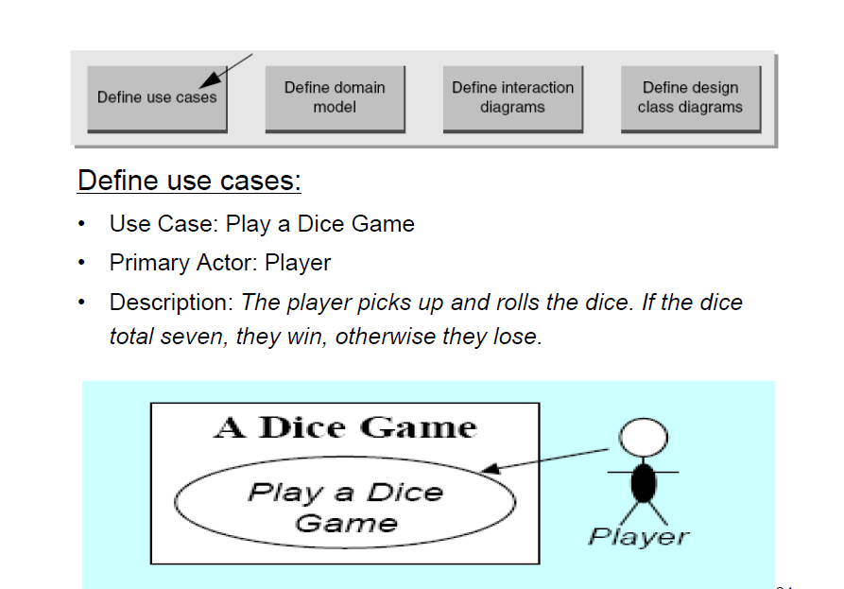
Object-Oriented Analysis and Design Cont.
Notes:
Use case: roll dice --- if (7 || 11) -> win, else lose;

Slide 5
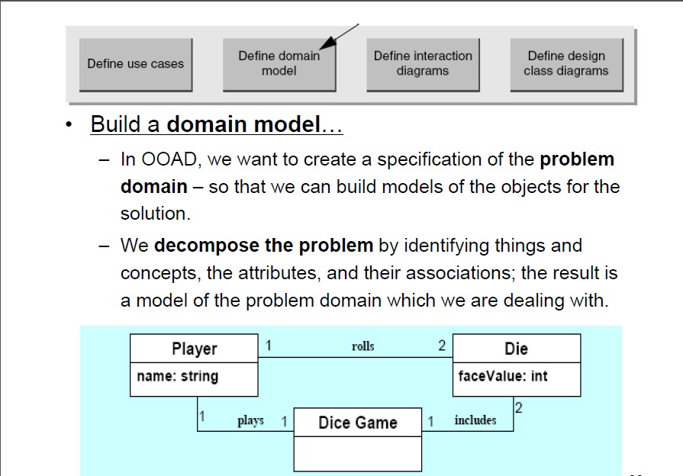
Object-Oriented Analysis and Design Cont.

Slide 6
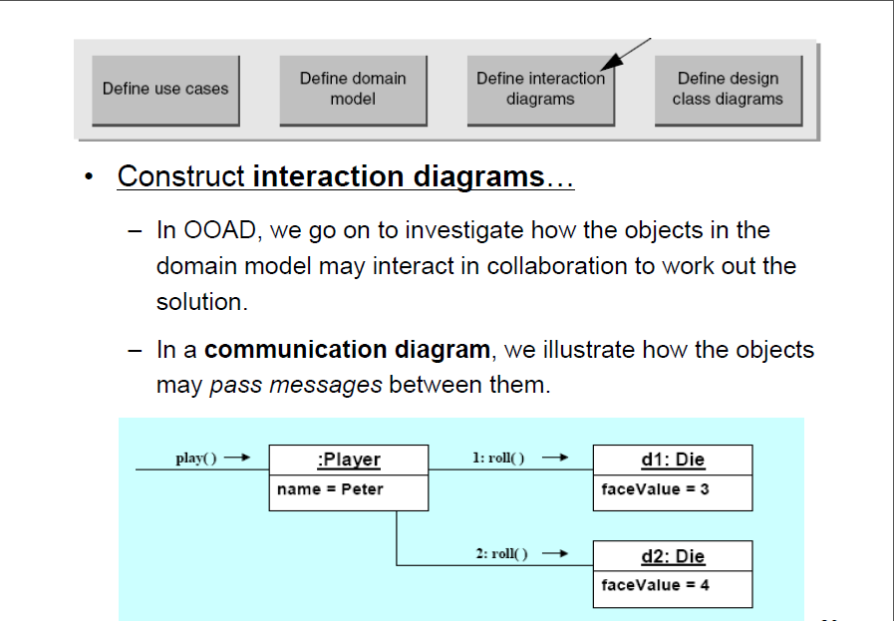
Object-Oriented Analysis and Design Cont.

Slide 7
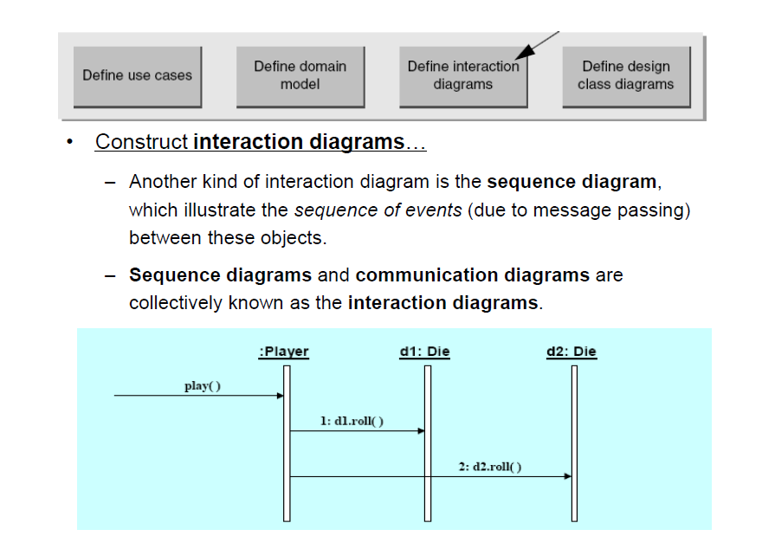
Object-Oriented Analysis and Design Cont.

Slide 8
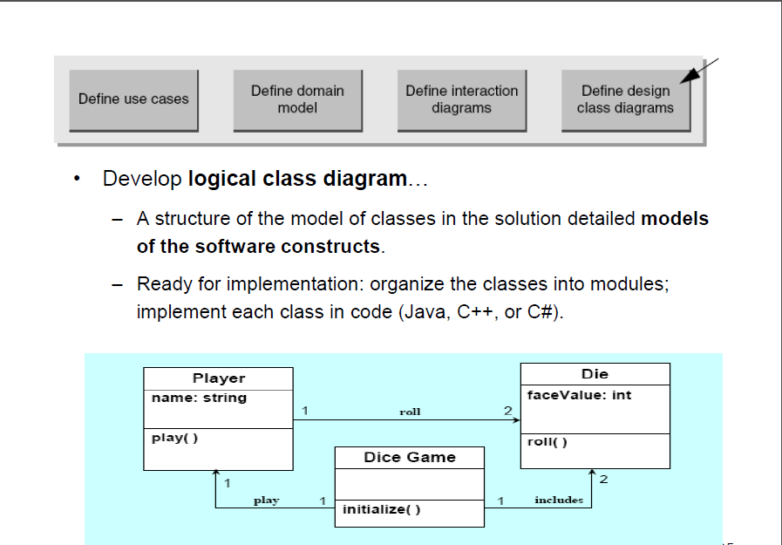
Object-Oriented Analysis and Design Cont.

Slide 9
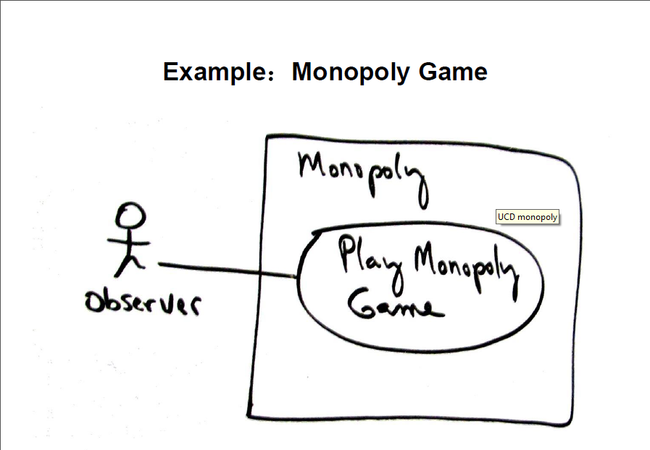
Object-Oriented Analysis and Design Cont.

Slide 10
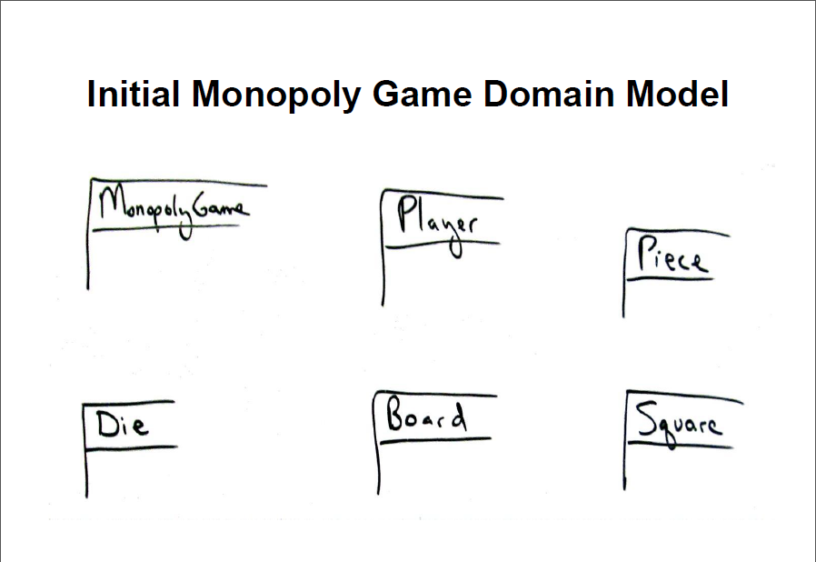
Object-Oriented Analysis and Design Cont.

Slide 11
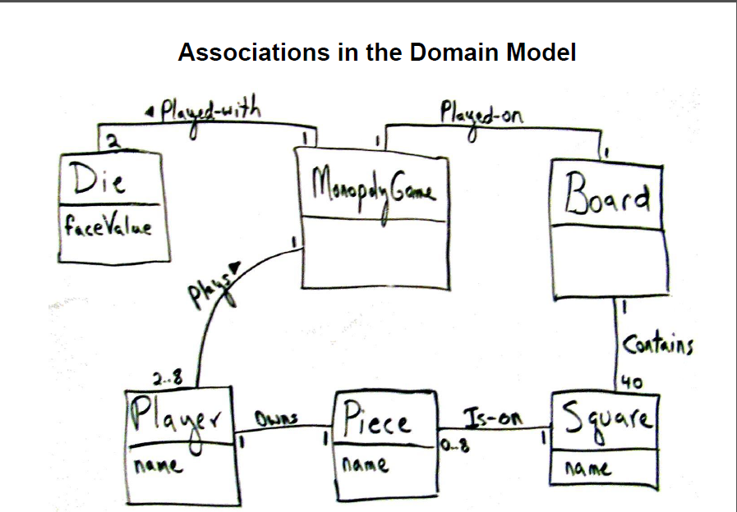
Object-Oriented Analysis and Design Cont.

Slide 12
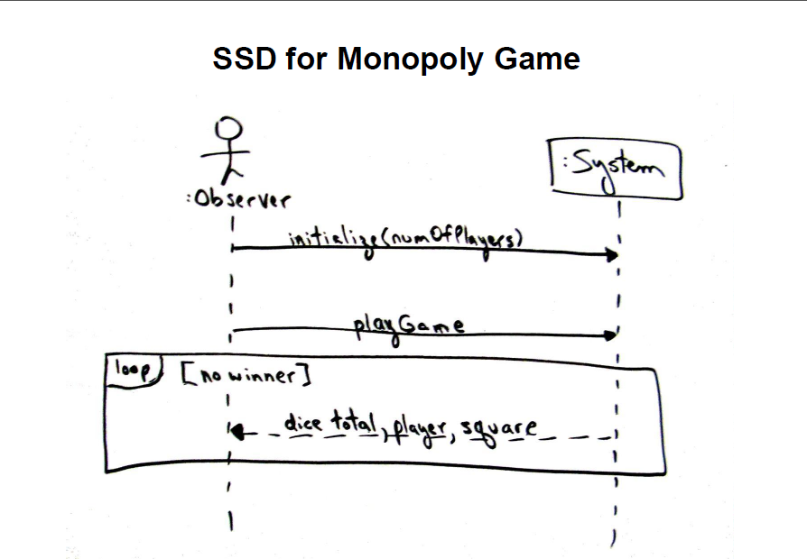
Object-Oriented Analysis and Design Cont.

Slide 13
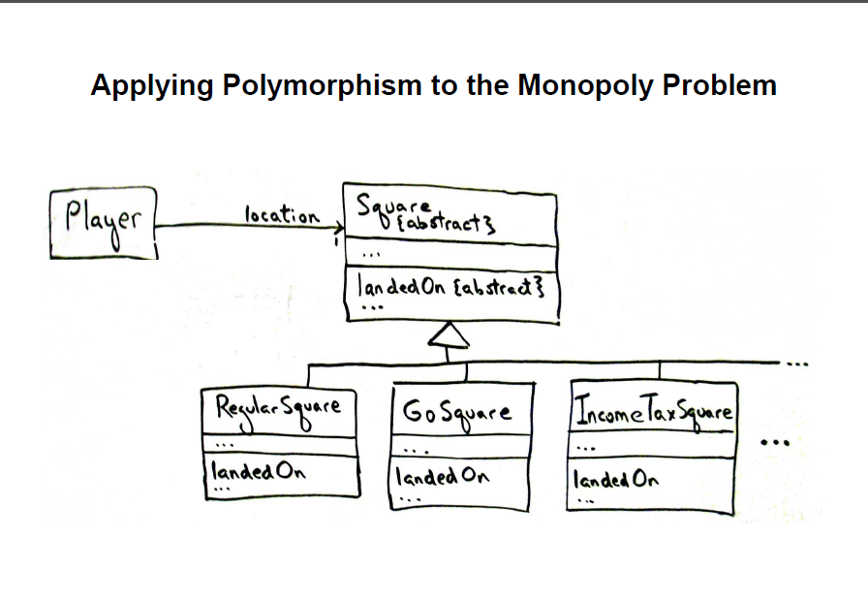
Object-Oriented Analysis and Design Cont.

Slide 14
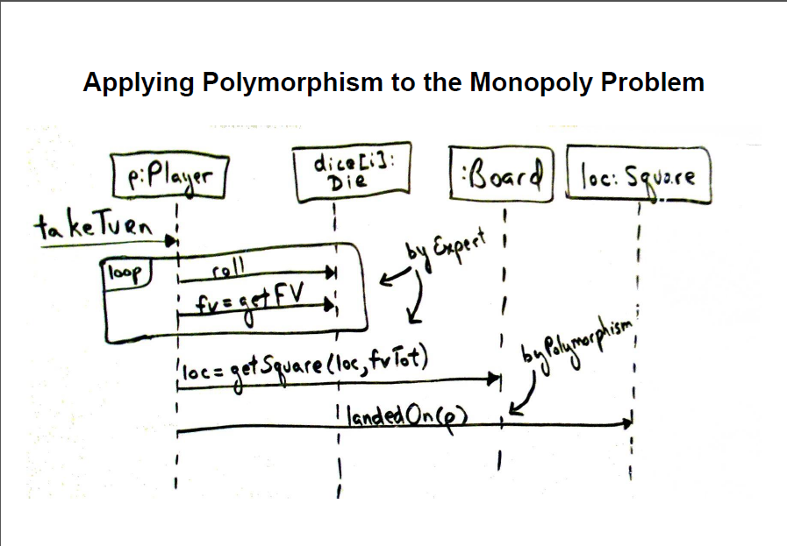
Object-Oriented Analysis and Design Cont.

Slide 15
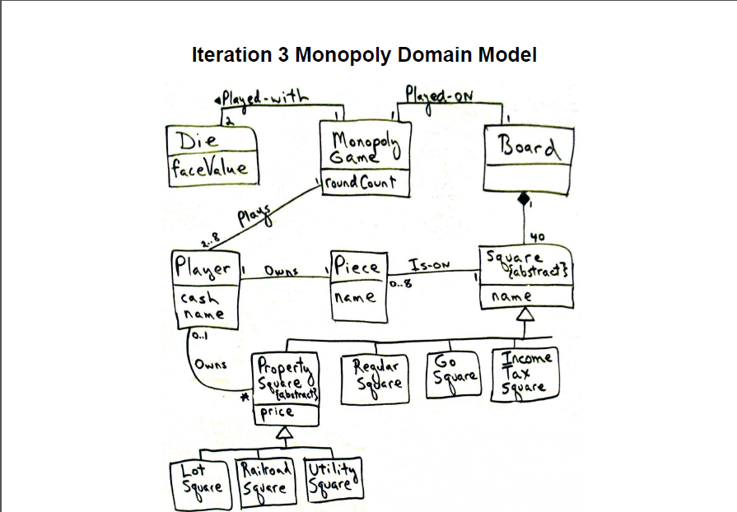
Object-Oriented Analysis and Design Cont.

Slide 16
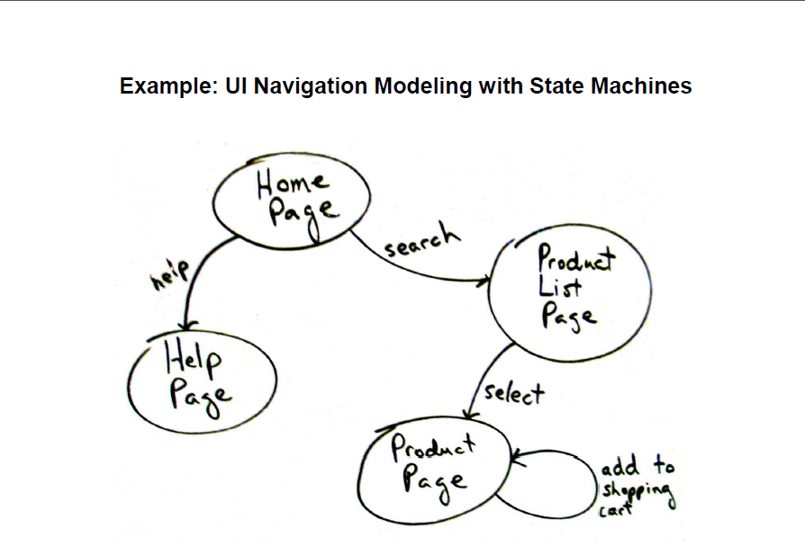
Object-Oriented Analysis and Design Cont.

